Slide 1

Software Design and Arcitecture(SDA) Lecture 10
Engr.Ramsha Mashood
Senior Lecturer
Department of Software Engineering
Bahria University Karachi Campus

Slide 2




Architectural design issues; architectural description language

Slide 3

Architectural design issues

Slide 4
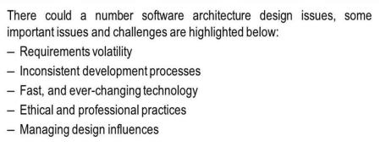

Slide 5
Architecture description languages (ADLs)

Slide 6
Architecture description languages (ADLs) are formal languages that can be used to represent the architecture of a software-intensive system. As architecture becomes a dominating theme in large system development, methods for unambiguously specifying architecture will become indispensable.

Slide 7
Architecture is a broad concept, and each project/domain's notion of what an architecture is and what sorts of data it should contain is different (and rightly so!) Furthermore, the purpose of an architecture description is largely driven by project stakeholders and their needs. Thus, no one ADL will ever fit all projects or domains. — Eric M. Dashofy

Slide 8
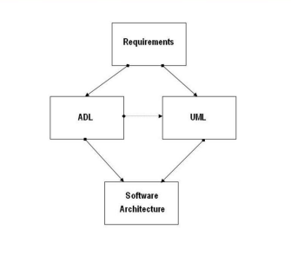
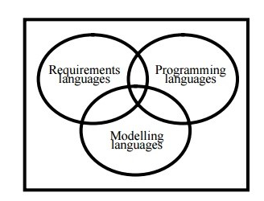
An architecture can choose the type of component most appropriate or informative to show, or it can include multiple views of the same system, each illustrating different componentry.

Slide 9
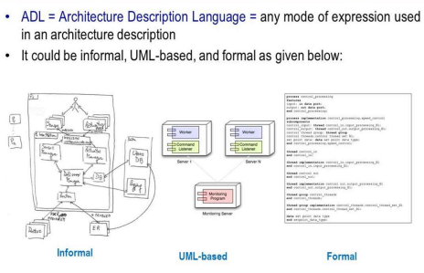

Slide 10
The software engineering community uses an architecture description language as a computer language to create a description of a software architecture.
In the case of a so-called technical architecture, the architecture must be communicated to software developers.
Functional architecture is communicated to various stakeholders and users.

Slide 11
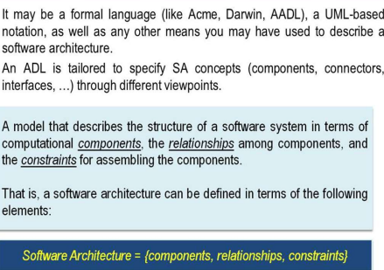

Slide 12
Architectural Description Language
By architecture, we mean the components that comprise a system, the behavioral specifications for those components, and the patterns and mechanisms for interactions among them.
A single system is usually composed of more than one type of component: modules, tasks, functions, etc.
An architecture can choose the type of component most appropriate or informative to show, or it can include multiple views of the same system, each illustrating different componentry.

Slide 13
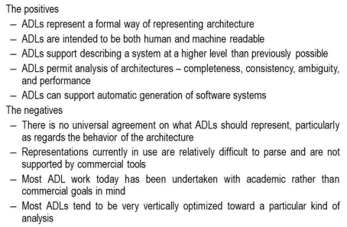
Architectural Description Language

Slide 14
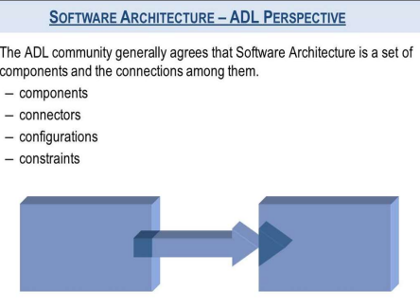

Slide 15
Architectural Description Language
Some ADLs that have been developed are:
Acme (developed by CMU)
AADL (standardized by the SAE)
C2 (developed by UCI)
SBC-ADL (developed by National Sun Yat-Sen University)
Darwin (developed by Imperial College London)
Wright (developed by CMU).

Slide 16
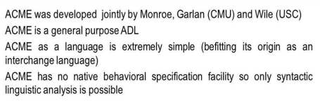
ACME

Slide 17
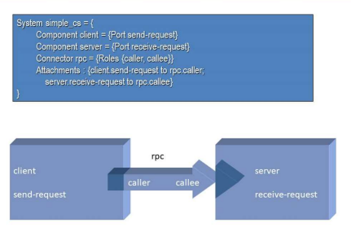
Example

Slide 18
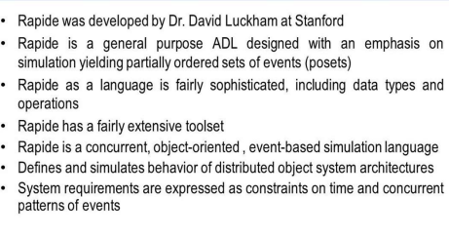
RAPIDE

Slide 19
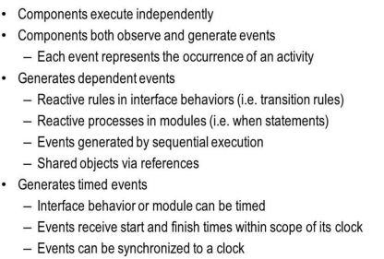

Slide 20
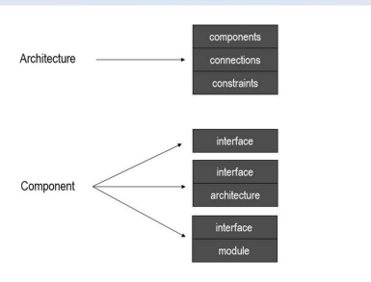

Slide 21
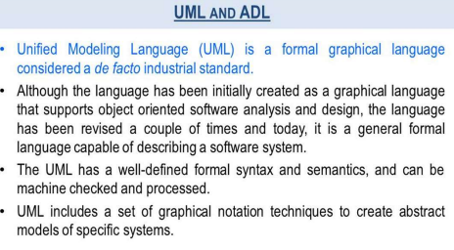

Slide 22
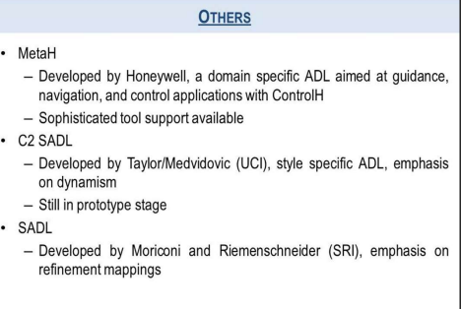

Slide 23
Continue….
Any thing to ask ??

